Slide 1
EMPLOYEE PERFORMANCE ANALYSIS USING EXCEL
STUDENT NAME : GNANAMANI S
REGISTER NO. : 2213391036216
DEPARTMENT : B.COM GENERAL
COLLEGE : Queen Mary’s College

Slide 2
PROJECT TITLE
Employee Performance Analysis Using
Excel

Slide 3
AGENDA
1. Problem statement
2. Project overview
3. End users
4. Our solution and proposition
5. Dataset Description
6. Modelling Approach
7. Results and discussion
8. Conclusion

Slide 4
PROBLEM STATEMENT
Performance analysis are made to a employee increment to check the performance track of the employee personal as well as organisation Growth.
So, the employee performance analysis helps to require all the problem and have a successful organisation.

Slide 5
PROJECT OVERVIEW
Analysis the performance of the employee by considering the various factory like :
Gender, performance score and Ratings.
Their involvement work and various scores that analysis the performance of employees in the organisation.

Slide 6

WHO ARE THE END USERS ?

Slide 7

OUR SOLUTION AND ITS VALUE PROPOSITION
Conditional formatting – missing values
Filtering : remove missing data
Formula : performance evaluation
Pivot : summary
Graph : data visualization

Slide 8
DATASET DESCRIPTION
EMPLOYEES DATABASE KIGGLE
There are 26 features but we consider 9 features
Employees ID Numerical data
Name Text
Performance Level
Gender Male or Female
Employees rating Numerical data.

Slide 9

THE “ WOW “ IN OUR SOLUTION
Sample Queries :
Get all characters in a guild: SELECT* FROM characters JOIN
Members ON characters ID =characterID WHERE GuildID = [GuildID]
Get all raids a character has participated in: SELECT * FROM
Raids JOIN Raid Members ON RaidID = RaodID WHERE characterID = [CharacterID]
This database design captures key WoW data and relationships, enables you to store.

Slide 10
MODELLING
Data collection
Feature collection
Data cleaning
Performance Level
Summary
Visualization

Slide 11
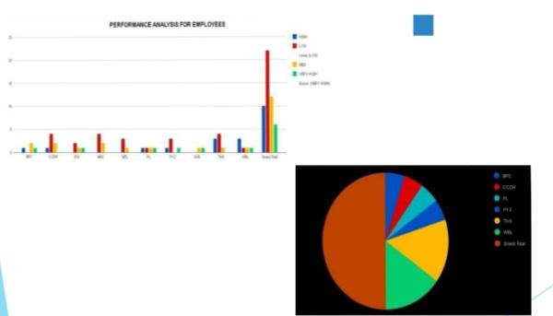
RESULTS

Slide 12
CONCLUSION
While comparing the performance of employees, the number of employees are higher in number is in the average performance where excellence employees are less in percentage. So to overcome this we should motivate the employees by giving there different tasks based on their skills to improve their performance in their work.

Slide 13
THANK YOU 🙏🏻

